Slide 1
Loan Status Prediction Project Analysis

Slide 2
1 Smart Insights on Loan Prediction Model Development

Slide 3
Project Overview & Objectives
Predict Loan Status
Dataset Insights
Problem Statement
Model Building Goal
The core objective is to predict whether a loan application will be approved or not, framing it as a binary classification challenge.
We're working with a dataset of 614 records and 13 columns, which shrinks to 480 records after handling missing values
Loan decisions hinge on various applicant details, including financial, demographic, credit, and property information.
The aim is to construct a robust machine learning model using historical loan application data, ensuring data cleanliness and proper encoding.

Slide 4
Data Preparation & Exploration
Key Applicant Data
Target Variable Focus
Applicant information like Gender, Married status, Dependents, and Education are crucial features for our model.
The 'LoanStatus' is our key target, with 'Y' for approved and 'N' for not approved, which we'll encode numerically.
Categorical Encoding
Handling Missing Values
Missing values were efficiently managed by dropping rows, ensuring a clean dataset for model training.
Categorical variables were meticulously converted into numerical representations to prepare them for the machine learning algorithm.

Slide 5
Model Training & Evaluation
SVM Algorithm Choice
Accuracy Score
We've selected the Support Vector Machine (SVM) with a Linear Kernel, implemented via sklearn.svm.SVC, for this classification task.
Our primary evaluation metric is the Accuracy Score, which revealed a training accuracy of 79.86% and a testing accuracy of 83.33%.
Train-Test Split
Future Enhancements
The cleaned dataset was split into a training set of 432 records and a testing set of 48 records, using a stratified approach.
Future scope includes exploring advanced imputation techniques, comparing other classifiers, and deploying the model for practical use.

Slide 6
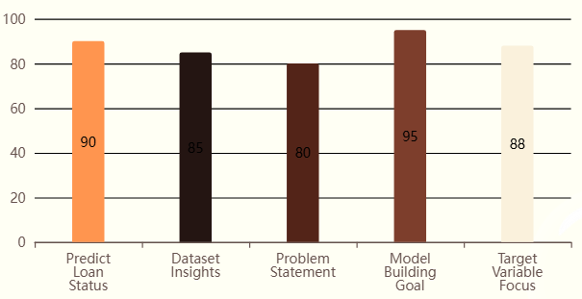
Loan Prediction Project Analysis Overview
Key Aspects of Loan Prediction Project(Effectiveness Score (%))

Slide 7
2 Evaluating Machine Learning Classification Project Outcomes

Slide 8
Project Overview & Objectives
Predict Loan Approval
Build ML Model
The primary objective is to predict whether a loan application will be approved or not approved, framing it as a binary classification task.
A machine learning model is constructed from historical loan application data to automate the decision-making process.
Clean & Preprocess Data
Dataset Characteristics
The dataset undergoes cleaning and preprocessing, including handling missing values and encoding categorical variables into numerical forms.
The initial dataset comprises 614 records and 13 columns, reduced to 480 records and 11 features after cleaning.

Slide 9
Model Training & Evaluation
SVM Algorithm Used
Accuracy Score Metric
A Support Vector Machine (SVM) with a linear kernel, implemented via sklearn.svm.SVC, is the chosen algorithm for classification.
The model's performance is evaluated using the Accuracy Score, yielding a training accuracy of 79.86% and a testing accuracy of 83.33%.
Train-Test Split
Limited Evaluation Metrics
The cleaned dataset is split into a training set (432 records) and a testing set (48 records) using a stratified 10% test size.
The current project's evaluation is limited to accuracy, lacking precision, recall, F1-score, ROC-AUC, or confusion matrix analysis.

Slide 10
Conclusion & Future Scope
End-to-End Workflow
Improvement Areas
Future enhancements include implementing missing value imputation, creating reusable preprocessing pipelines, and comparing additional classifiers.
This project successfully demonstrates an introductory, end-to-end machine learning classification workflow from data to model.
Achieved Accuracy
Further Model Refinement
The linear SVM model achieved a respectable 83.33% accuracy on the held-out test set, indicating its predictive capability.
Additional steps involve hyperparameter tuning, incorporating cross-validation, and potentially deploying the model as a web application or API.

Slide 11
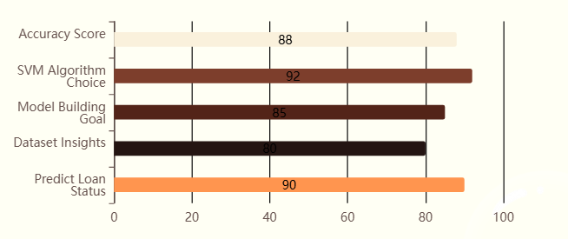
Loan Prediction Model Development & Evaluation
Key Aspects of Loan Prediction Model Performance(Effectiveness Score (%))

Slide 12
Thank You

